Slide 1
Organisms and Their Environment - Part 2
Science 7

Slide 2
Big Idea:
All living things are affected by their environment. Both the living and non-living parts of an environment can have impacts on the well-being of an organism.

Slide 3
Interactions Between Abiotic and Biotic Parts of the Environment
Ecology: Study of interactions between organisms as well as the interactions between organism and their environment.
Ecosystem: all the interacting organisms that live in an environment as well as the abiotic parts

Slide 4
List 5 abiotic and 5 biotic member of this ecosystem

Slide 5
Biomes
Biomes: large regions that have about the same temperature and rain/snow fall

Slide 6
Tundra

Slide 7
Boreal Forest

Slide 8
Temperate Forest

Slide 9
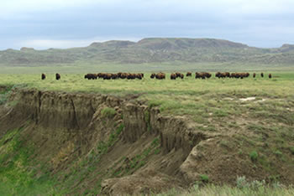
Grasslands

Slide 10
BC’s Ecosystem
72% of Canada’s mammals
60% of Canada’s plants
67% of Canada’s fungal species
79% of Canada’s birds

Slide 11
BC’s Ecosystem
BC has diversity in its geography and climate which contributes to the biodiversity of BC’s ecosystem.
Each of these different areas are called ecoprovinces

Slide 12
Indigenous Perspective
BC’s Indigenous people are considered BC’s first ecologists
They gathered information and knowledge about each region
Ecosystems are a whole not a collection of parts
All parts of the ecosystem are alive (spirit), related and sacred

