Slide 1
Organisms and Their Environment - Part 1
Science 7

Slide 2
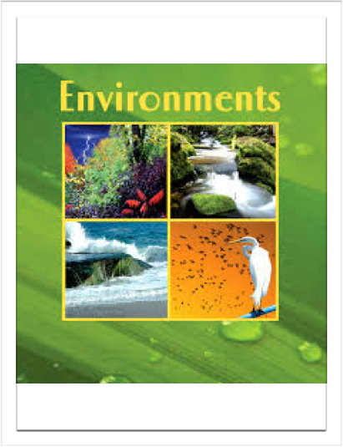
Big Idea:
All living things are affected by their environment. Both the living and non-living parts of an environment can have impacts on the well-being of an organism.

Slide 3
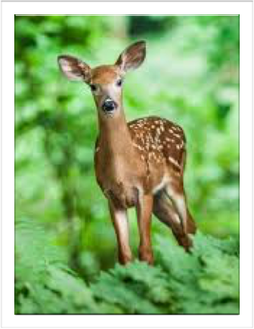

Example of Impacts: Deer
Impact by living things: predators, hunting, humans developing their territory
Impact by non-living things: weather change affecting crops, diseases, fires

Slide 4
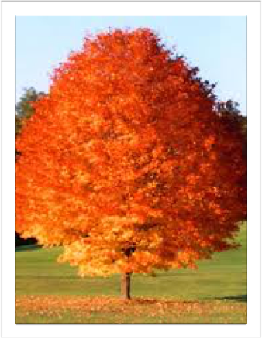
Example: A Red Maple Tree
Impact by living things: deforestation by humans, fungal infection - verticillium wilt & root rot
Impact by non-living things: fires, global warming, viruses

Slide 5
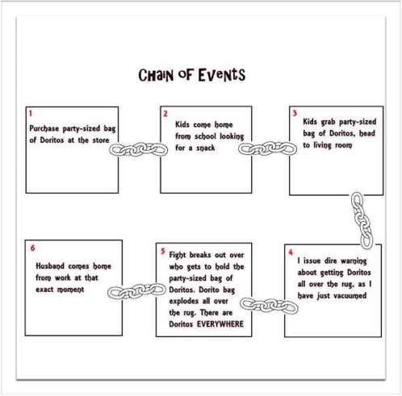
Activity: Chain of Events
One event can often set off a chain of events where impacts are felt by other organisms

Slide 6
Definitions
Abiotic: The non-living parts of the environment
Biotic: The living parts of the environment

Slide 7
Needs of Living Things
- Oxygen or Carbon Dioxide (plants)
- Water
- Food
- Shelter/Suitable Place to Live

Slide 8
Salty Seed Activity
Materials:Bean seeds, salt, water, 2 cups, paper towels
Question: How will salt affect the growth of the beans?
Experiments: 5 beans will be soaked overnight in salt water and 5 bean seeds will be soaked overnight in regular water. We will put them in paper towels and monitor how they sprout.
Write a hypothesis on your note sheet
*Remember if…. then….

