Slide 1
Human Adaptations
Looking at Mesopotamia

Slide 2
Human Adaptations - Definition
Interacting and adjusting to the environment.

Slide 3
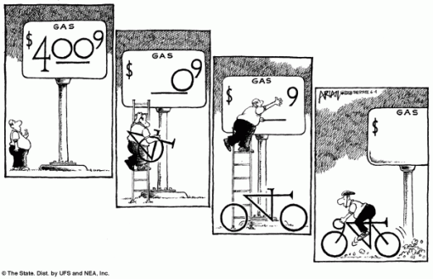
Anticipation Guide
How do the pictures on the next slides show humans adapting to the environment?

Slide 4
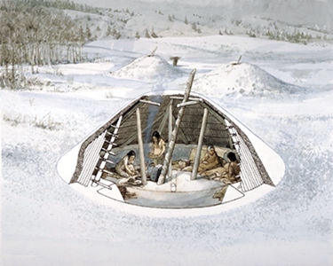
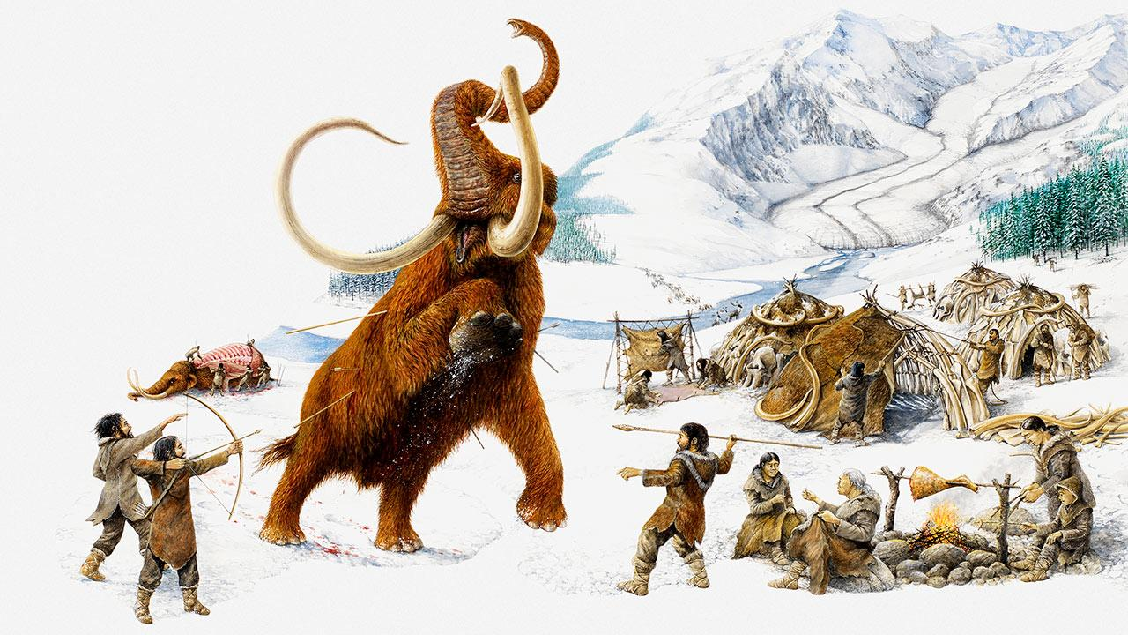
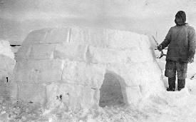
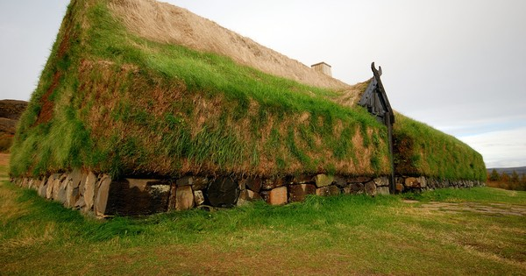

Slide 5
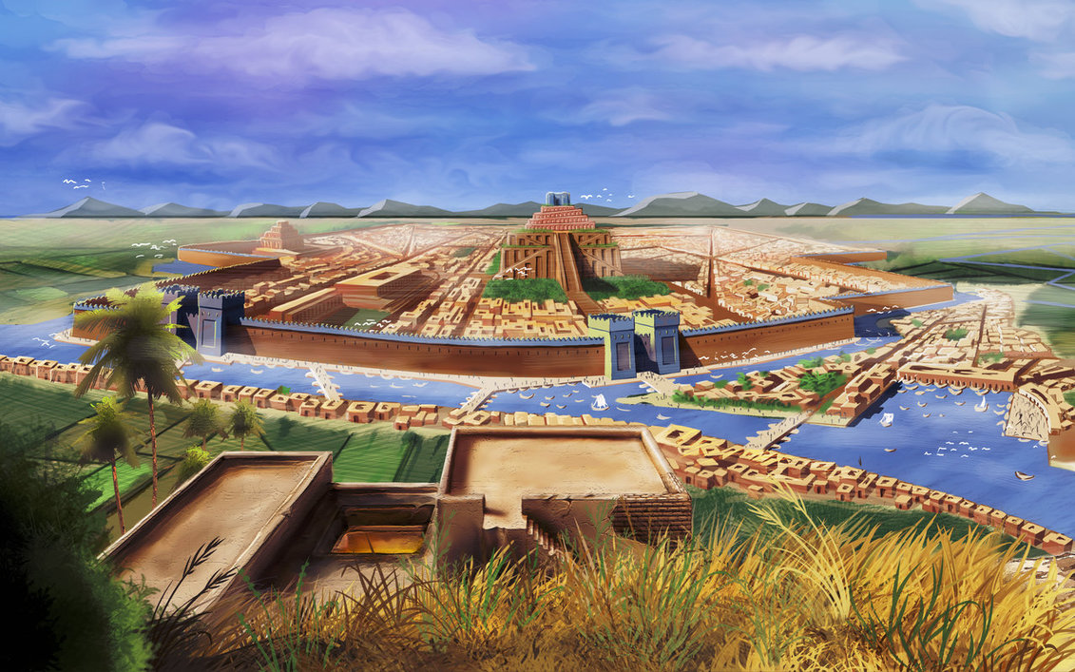
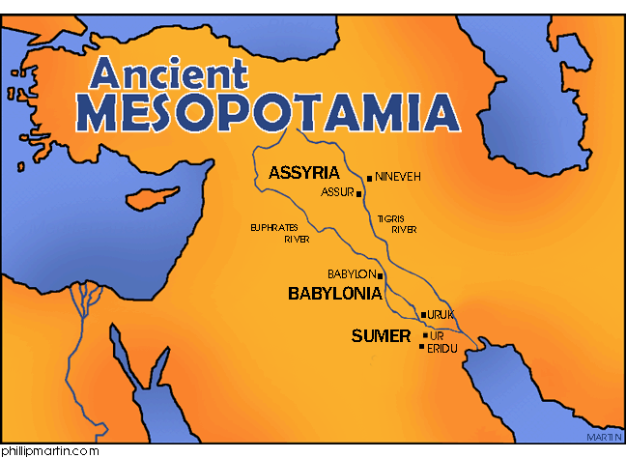
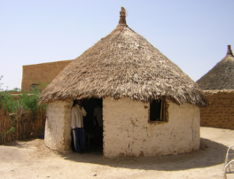
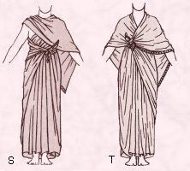
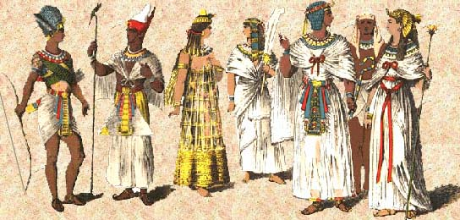

Slide 6
A Story about Mesopotamia

Slide 7
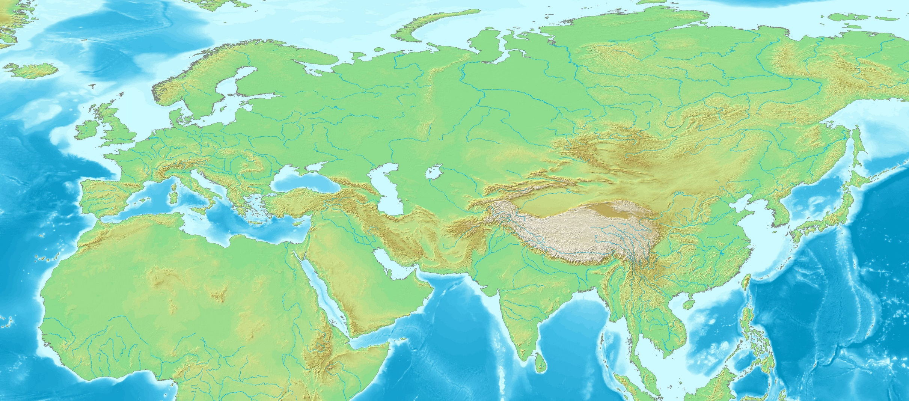
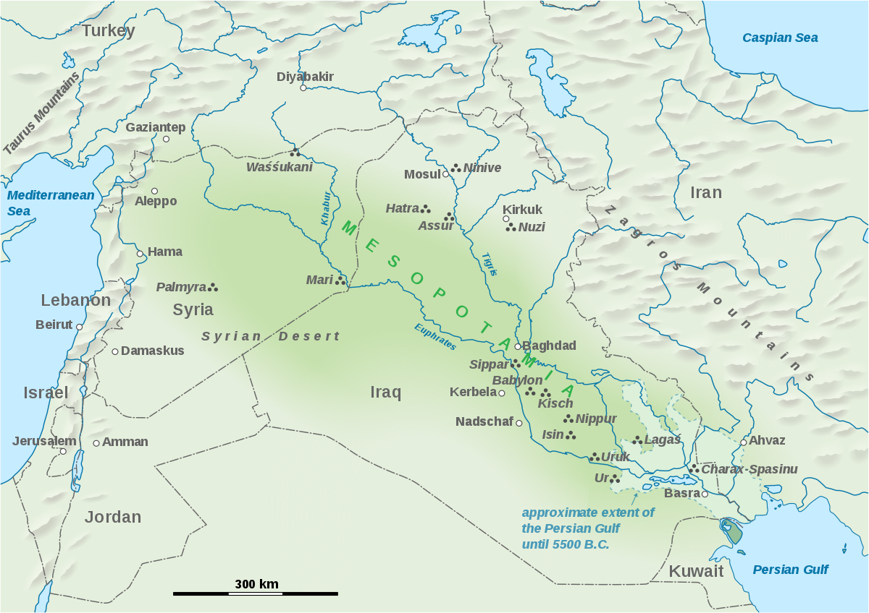
About 4000 years ago, people began to settle in the Middle East between the Tigris and Euphrates Rivers (modern day Syria, Iraq, and Iran). The river valley offered the natural resources for food and water, and landforms like the mountains to the north and the rivers offered protection and the ability to travel and trade. This area was hot, dry, and received little rainfall, but the first farmers who settled there saw great potential. Mesopotamia quickly grew into the first civilization in human history; the “cradle of civilization”. Mesopotamia means “the land between two rivers” because it was literally located between two large rivers. The land here was very fertile and the first human cities thrived there for over 3000 years. People in Mesopotamia were among the earliest inventors, creating the first system of writing, the wheel, the earliest forms of mathematics, and being the first to work with metal. But most importantly, they were masters at adapting to their land, climate, and natural resources. Mesopotamians needed to be able to control their rivers so they could prosper. They quickly became experts at it. Future civilizations learned from the Mesopotamians about how to live off the land and many inventions in Mesopotamia are still SUPER IMPORTANT to our lives today. There were 6 main ways in which Mesopotamia first, and future civilizations, adapted to their environment…

Slide 8
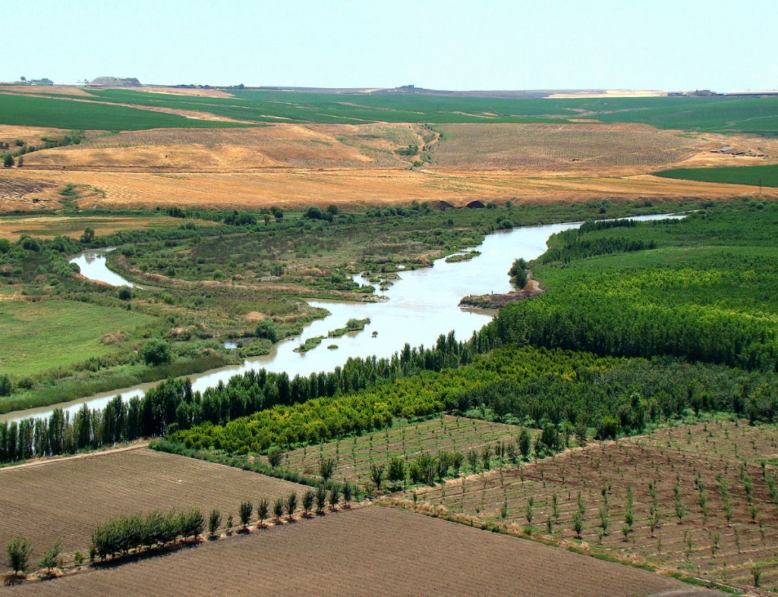
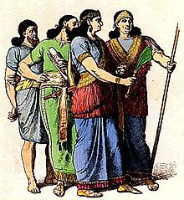
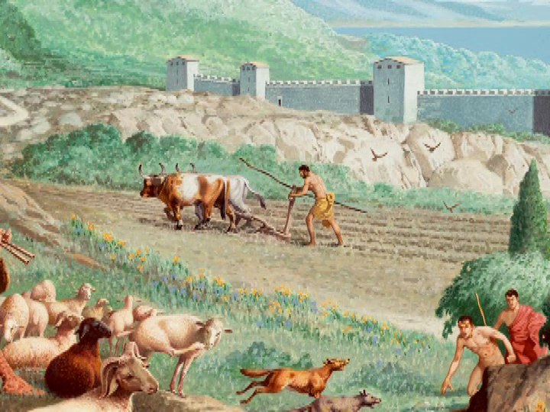
Ways that humans adapt to their
environment!
1) Farming (irrigation!)
2) Clothing
3) Shelter
4) Transportation (Trade!)
5) Domesticating Animals
6) Innovations (Tools!)

Slide 9
Placemat Activity

