Slide 1
DIGITAL CITIZENSHIP | GRADE 7
The Power of Digital Footprints

Slide 2
Essential Question
How might our digital
footprints shape our future?

Slide 3
Learning Objectives
l
Define the term "digital footprint" and explain how it can affect our online privacy.
Analyze how different parts of our digital footprint can lead others to draw conclusions -- both positive and negative -- about who we are.
Use the Take a Stand thinking routine to examine a dilemma about digital footprints.
2
3

Slide 4
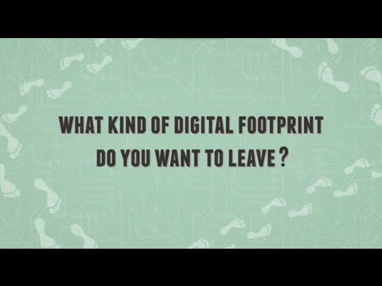
WATCH + DISCUSS
Discuss:
What images are used in the video?
What do they represent?
To watch this video on the Common Sense Education site, click here.

Slide 5
KEY VOCABULARY
Digital footprint
All the information online about a person posted either by that person or by others, intentionally or unintentionally
Persistent
Lasting a long time

Slide 6
KEY VOCABULARY
Invisible audience
Unknown or unanticipated people who can see information about you posted online.

Slide 7
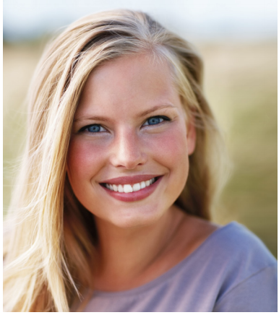
GROUP ACTIVITY
Take a Stand
Chat App
Document No. 6: Private Chat Description: Private chat between Iliana and anonymous friend Search notes: Received by anonymous sender
 | Hey I saw your blog, I thought you hated cooking?!! 😜
 | Oh yah I don’t LOVE it...I made it because the Truth Be Told application wanted people to have a blog or something to show you have an audience online.
 | Isn’t that like cheating tho?....
 | No, why would it be? I’m just doing it for the job application. If I’m hired they don’t need to know I can barely make toast! Who cares!

Slide 8
GROUP ACTIVITY
Take a Stand
On your own | TAKE A STAND What do you think? Explain your perspective.
As a group | STAND BACK Where do your classmates stand? Listen to their perspectives.
On your own | LOOK AGAIN Look again at your original response. What had you not considered that other people brought up? (Maybe you changed your mind, maybe you didn't -- that's OK! Either way, you heard other views. How has your thinking shifted after hearing your classmates' perspectives, even if you haven't changed your mind?)
As a group | LOOK BEYOND Look beyond this specific case. How does this dilemma remind you of other situations we've explored in class or that you've seen, heard about, or experienced?

Slide 9
APPLY: MY DIGITAL FOOTPRINT
Ways to Shape Your Footprint
[Capture student responses here.]

Slide 10
