Slide 1
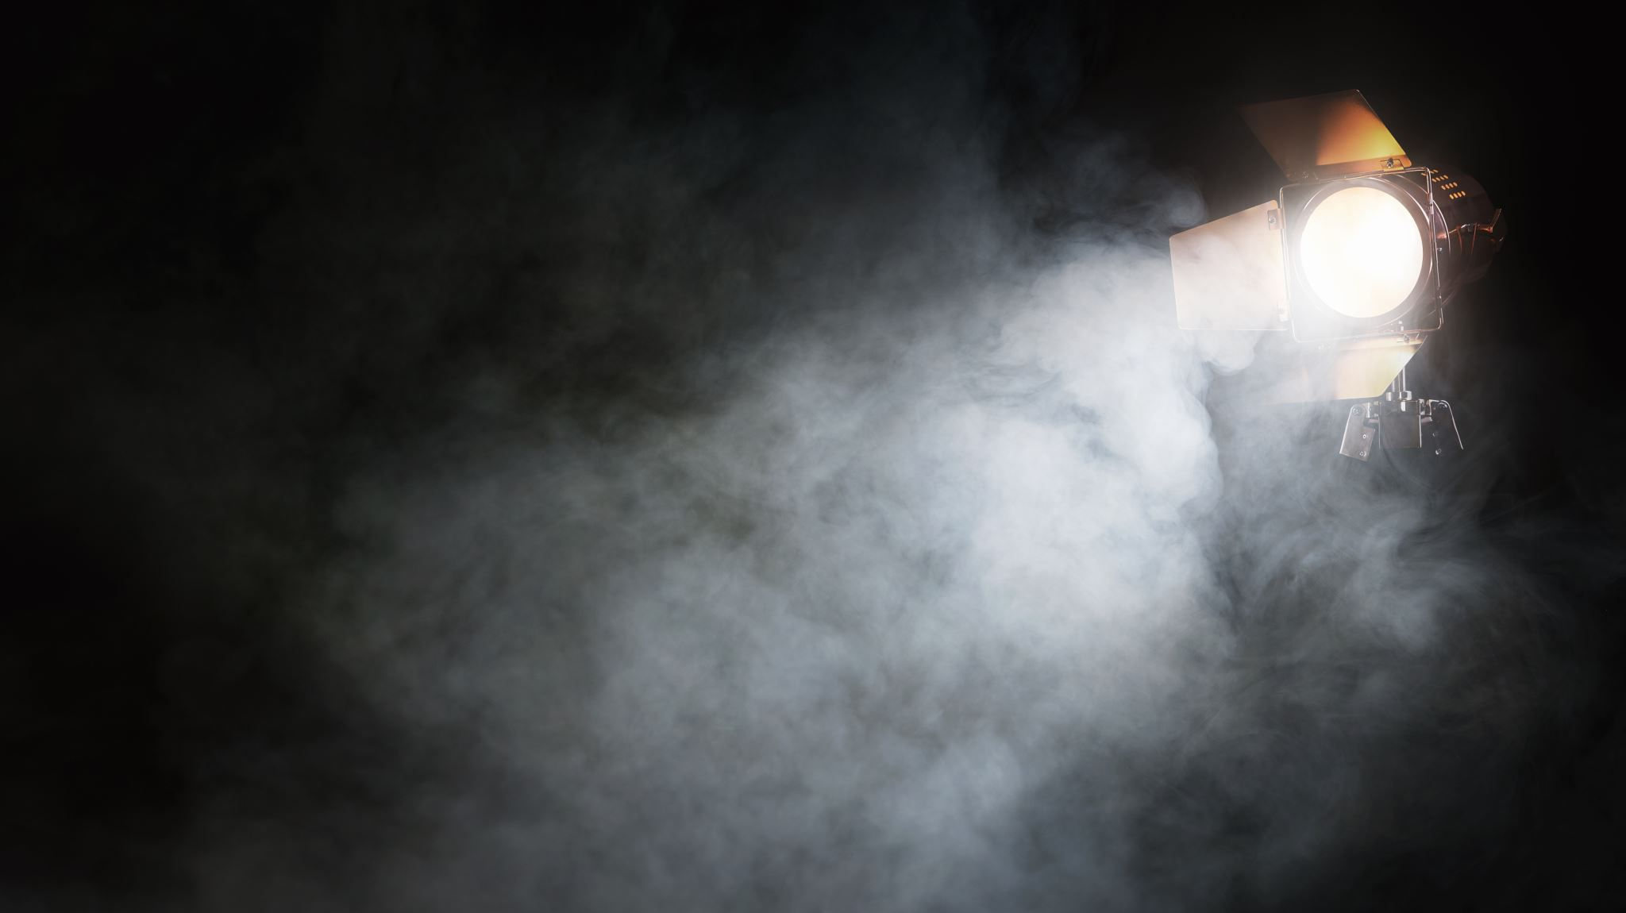
Documentary Analysis
Non-Fiction Writing

Slide 2
What is media? What are examples of media?

Slide 3
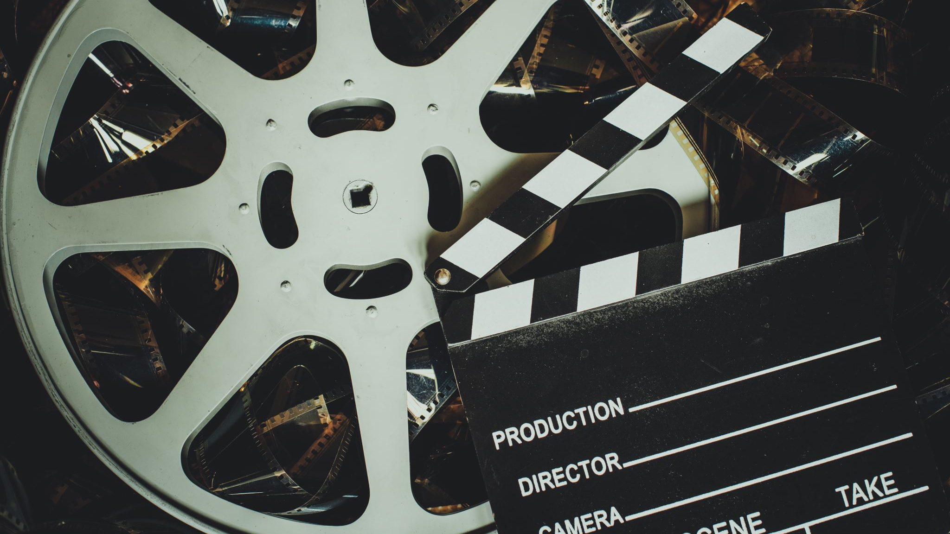
What is a documentary? How are documentaries different from movies? What documentaries have you seen?

Slide 4
What is a documentary?
A movie, television, or radio that provides a factual record or report. Documentaries can cover a WIDE variety of topics, from people, to nature, to events.

Slide 5
The documentary we will be watching:

Slide 6
What this documentary is about:
This documentary looks at Apricot Lane Farms, a traditional foods farm started by John and Molly Chester, a husband-and-wife team, who left their jobs in Los Angeles to become farmers and pursue their dream vision of starting the farm in 2011. Located 40 miles north of Los Angeles, the farm is dedicated to the mission of creating a well-balanced eco-system and rich soils that produce nutrient-dense foods while treating the environment and the animals with respect. Apricot Lane farm residents include pigs, goats, sheep, chickens, ducks, guinea hens, horses, highland cattle, and one brown swiss dairy cow named “Maggie.” Many of which, you will meet in the Biggest Little Farm. The land consists of Biodynamic Certified avocado and lemon orchards, a vegetable garden, pastures, and over 75 varieties of stone fruit. The residents of Apricot Lane Farms face many challenges and overcome many obstacles, from nature and within.

Slide 7
Trailer

Slide 8
Background knowledge (KWL Chart): What is a farm? Who or what lives on a farm? What kind of work happens on a farm?

Slide 9
Definitions (KWL Chart):
• Biodiversity – the variety of life in the world
• Ecosystem – a group of living organisms that interact with each other
• Sustainable – able to be maintained
• Regenerative – to regrow or be renewed or restored
• Coexist – to exist in the same time and place

